Slide 1
The Rules of the game
Info Session on the Horizon Results Booster
prepared by Alessia Melasecche Germini
date 05.10.2021

Slide 2
The Initiative
The Horizon Results Booster an
European Commission initiative
which aims to maximise the impact of research projects
funded by FP7, Horizon 2020 and Horizon Europe.
If you need some guidance on
how best to disseminate and exploit
your research results,
then this programme is for you!

Slide 3
General eligibility
All EU-funded projects are eligible
Ongoing or completed
Directly funded by FP7, H2020, HE
Indirectly funded by FP7, H2020, HE
(e.g. by KICs, art. 185, etc.)

Slide 4
The Services
Three main services are provided:
Service 1 - Portfolio Dissemination and Exploitation Strategy - develop a portfolio of results and design an effective dissemination and exploitation strategy.
Service 2 - Business Plan Development - develop an effective business plan and find out how to secure additional funding for implementation of the plan.
Service 3 - Go to Market - get your research ready for commercialisation!

Slide 5
Service eligibility and requirements
Service 1 – Portfolio Dissemination and Exploitation Strategy (PDES)
Module A: Identification and creation of the portfolio of R&I project results | Application is open to both individual projects and project groups (PGs).
Module B: Portfolio Dissemination Plan (design and execution) | Application is open only to PGs. PGs that applied also to PDES-A can be enlarged before starting PDES-B. A portfolio of results has to be provided at the application stage.
Service 1 – Portfolio Dissemination and Exploitation Strategy (PDES)
Module C: Assisting projects to improve their existing exploitation strategy | Application is open only to single projects. Upload of exploitation plan is optional. Focus is on 3 Key Exploitable Results (KERs).
Service 2 - Business Plan Development (BPD)
Application is open only to single projects. Focus is only on 1 KER. An Exploitation Plan should be available/Draft Business Plan. | Application is open only to single projects. Focus is only on 1 KER. An Exploitation Plan should be available/Draft Business Plan.
Service 3 - Go-To-Market Support (G2M)
6 different support typologies are available. Some of them are only for individual projects. Not all support typologies can be selected (max # of EWDs per project). A (draft) Business Plan should be available. Focus is only on 1 KER. | 6 different support typologies are available. Some of them are only for individual projects. Not all support typologies can be selected (max # of EWDs per project). A (draft) Business Plan should be available. Focus is only on 1 KER.
Services flow
Dissemination services and exploitation services can run in parallel and have different experts’ teams delivering them.

Slide 6
Why should you benefit from HRB services? 1/2
Generation of an impact (on society and/or market) strictly depends on Dissemination exploitation and strategy and implementation.
Wrong basics, generate wrong strategies! => when projects go “out of the lab” the “environment” could be different from what they planned/expected
Experiences from the delivery:
Wrong identification of KERs
Confusion between customers-end users-partners
Use model is not identified

Slide 7
Why should you benefit from HRB services? 2/2
Many projects (not only those funded by FP7, H2020 and HE) have several commonalities in terms of:
Contents
Target stakeholders/groups of interest
For Project Groups:
Joining forces through common dissemination activities may increase interest of relevant audiences and save resources (money) for implementing activities.
Joint dissemination activities may also have a better impact on policy makers.
Do not forget! HRB also provides support in the creation of a PG!

Slide 8
When requesting HRB services?
HRB services can be requested at any given moment by eligible projects. The sooner the better!
During the application you will be asked to specify the indicative quarter when you prefer the services starting to be delivered (could be up to 1 year after the submission of the application).
It is preferable to start the HRB service delivery once there is a clear idea of the results of the project. We suggest for example PDES-A and PDES-C (entry point services) to be started around M6.

Slide 9
Application Process

Slide 10
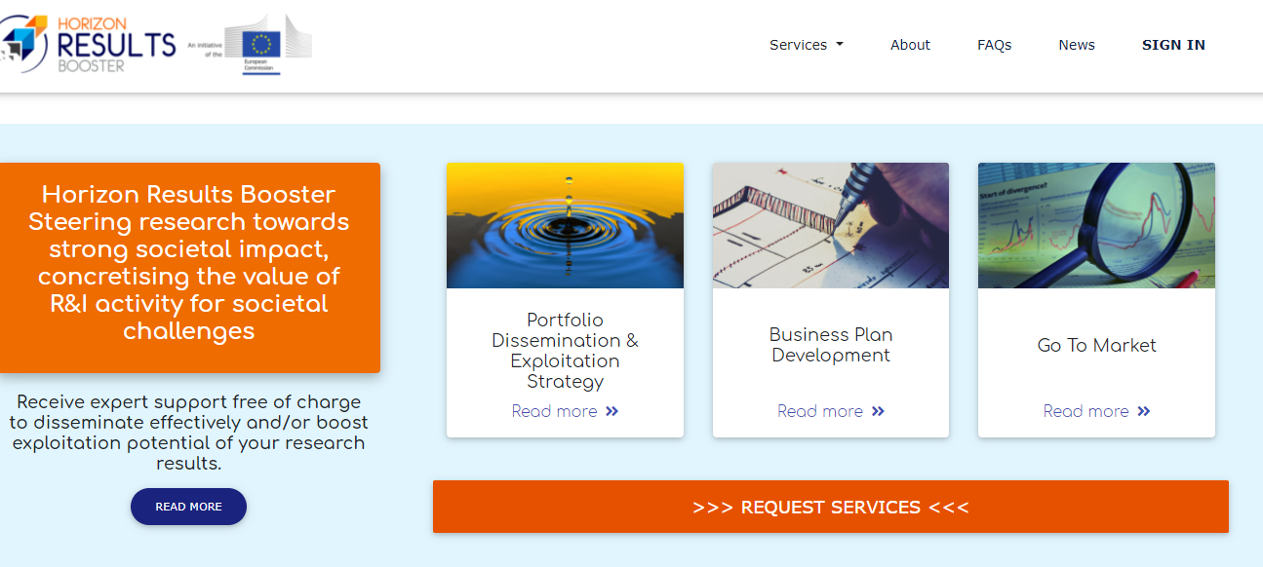
How can projects apply?
Application is public and open at www.horizonresultsbooster.eu
Click on the “request for services” button

Slide 11
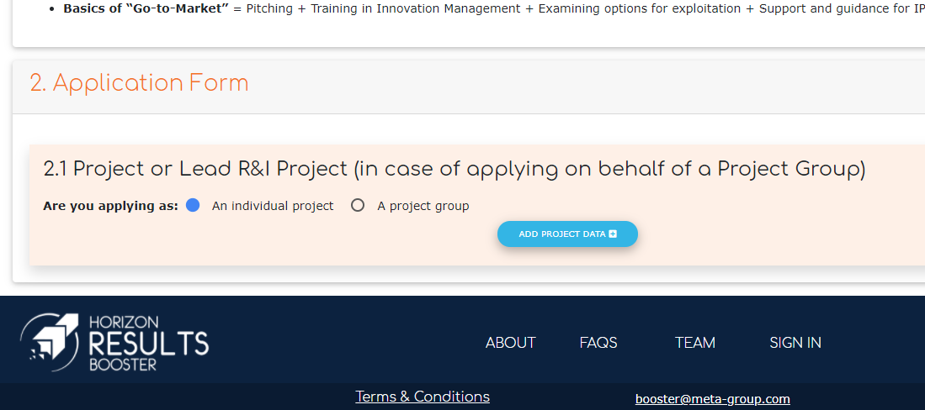
How can projects apply?
Fill out the application form (direct access through: https://www.horizonresultsbooster.eu/HRBApplications/ApplicationForm

Slide 12
How can projects apply?
Beneficiaries have to register first to the HRB platform to submit an application.
At the registration they need:
project ID (GA number)
name and e-mail of the applicant
name and e-mail of the project coordinator
name and e-mail of the PO
They can save draft applications and continue whenever they want before submitting.
During the application, specific questions are made and documents have to be uploaded, based on the service requested
Alerts keep applicants informed about their “readiness” for the requested service

Slide 13
What happens after the submission?
Eligibility of applications (minimum requirements, application to the same service, projects too far in the past, etc.) is verified by the EC – it could take around 3-5 days
Experts are proposed by the Contractor and accepted/rejected by the EC according to background, expertise, etc. in their CV – it take around 3-5 days
The expert contacts beneficiaries within 10 days from their appointment to organise a “preliminary call” to define the Service Delivery Plan.
If experts realise the projects are not “ready” for the service, they propose another service.
Feedback questionnaires are proposed at the end of the service to verify effectiveness.
Outputs, deliverables and final reports of the services are saved in the platform.
Automatic e-mail alert (to POs too) when the final report is uploaded onto the HRB platform.

Slide 14
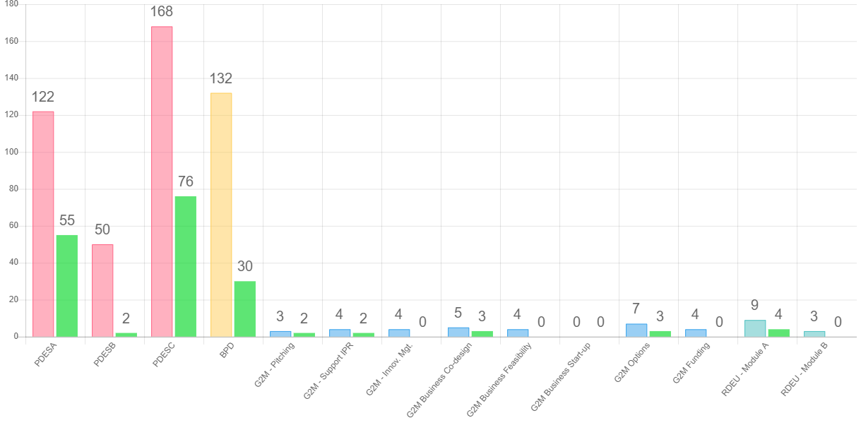
So far…

Slide 15
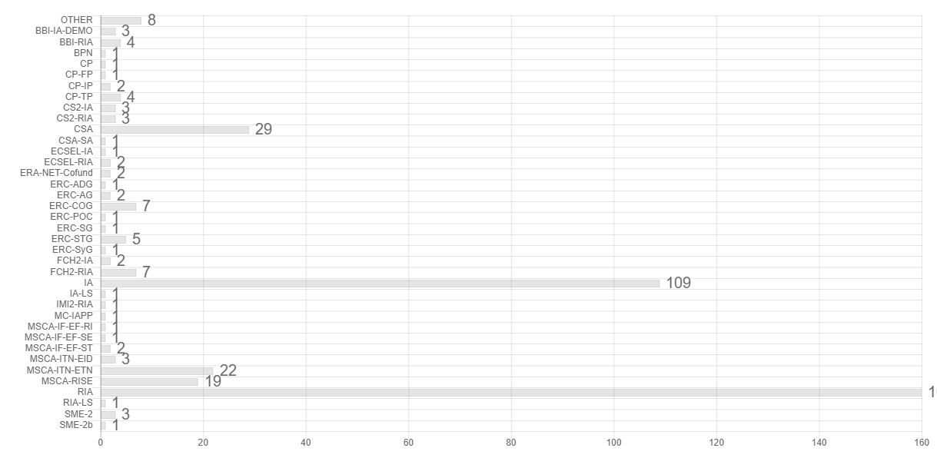
Not only RIAs…

Slide 16
Thank You for Your attention!
Alessia Melasecche Germini
booster@meta-group.com
www.horizonresultsbooster.eu

